Slide 1
Computer languages

Slide 2
Operating System
OS is an integrated collection of programs which make the computer operational and help in executing user programs.
It acts as an interface between the man and machine.
It manages the system resources like memory, processors, input-output devices and files.
Windows, Linux, DOS

Slide 3
Computer Languages
Machine Language- The only programming language available in earlier days
Consists of only 0’s and 1’s; e.g.:- 10101011
Symbolic language or Assembly language-
symbols or mnemonics are used to represent instructions
hardware specific
e.g. ADD X,Y; Add the contents of y to x
High-level languages- English like language using which the programmer can write programs to solve a problem.
more concerned with the problem specification
not oriented towards the details of computer
e.g.: C, C++, C#, Fortran, BASIC, Pascal etc.

Slide 4
Language Translator
Compiler : Program that translates entire high level language program into machine language at a time. e.g.:- C, C++ compilers.
Interpreter : Program which translates one statement of a high level language program into machine language at a time and executes it.
e.g.:- Basic Interpreters, Java Interpreters.
Assembler : Program which translates an assembly language program into machine language.
e.g.:- TASM(Turbo ASseMbler), MASM(Macro ASseMbler).

Slide 5
History of C
The C language was evolved by Dennis Ritchie at Bell Laboratories and was originally implemented on a DEC PDP(Digital Equipment Corporation-Programmed Data Processor)-11 computer in 1972.
C initially became widely known as the development language of the UNIX operating system.
Today, virtually all new major operating systems are written in C and/or C++.
C is available for most computers.
C is mostly hardware independent.

Slide 6
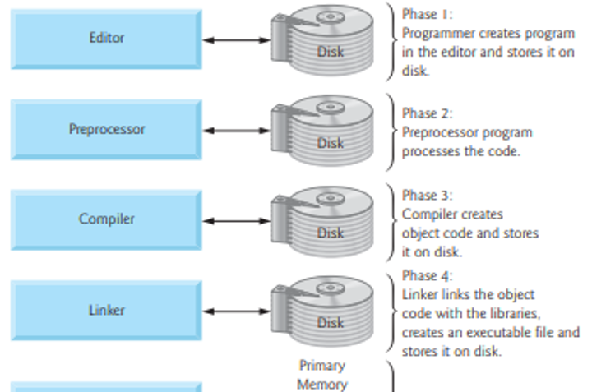
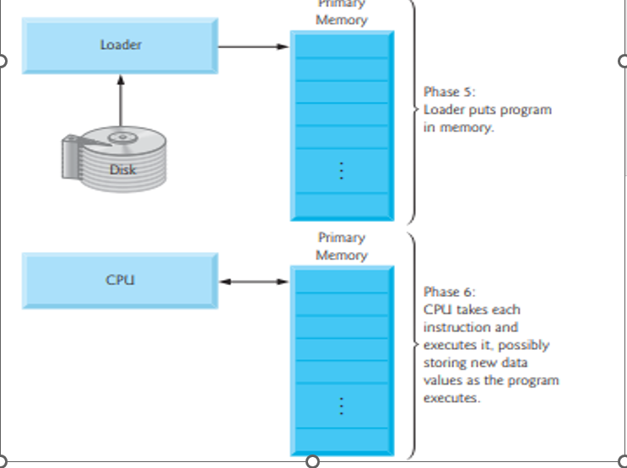
Typical C program development environment

Slide 7
Typical C program development environment
C programs typically go through six phases to be executed. These are: edit, preprocess, compile, link, load and execute
Phase 1 : creating a program
Phases 2 and 3: Preprocessing and Compiling a C Program
Phase 4: Linking
Phase 5: Loading
Phase 6: Execution
Notes:
Phase 1 : creating a program
Phase 1 consists of editing a file.
This is accomplished with an editor program
The editor Named CodeBlocks will be used for creating the program.
You type a C program with the editor, make corrections if necessary, then store the program on a secondary storage device such as a hard disk.
C program file names should end with the .c extension
Phases 2 and 3: Preprocessing and Compiling a C Program
In phase 2, you compile the program.
The compiler translates the C program into machine language-code (also referred to as object code).
In a C system, a preprocessor program executes automatically before the compiler’s translation phase begins.
The C preprocessor obeys special commands called preprocessor directives, which indicate that certain manipulations are to be performed on the program before compilation.
These manipulations usually consist of including other files in the file to be compiled and performing various text replacements.
The most common preprocessor directives are #include, #define etc.
In Phase 3, the compiler translates the C program into machine-language code.
Phase 4: Linking
C programs typically contain references to functions defined elsewhere, such as in the standard libraries or in the private libraries of groups of programmers working on a particular project.
The object code produced by the C compiler typically contains “holes” due to these missing parts.
A linker links the object code with the code for the missing functions to produce an executable image
Phase 5: Loading
Before a program can be executed, the program must first be placed in memory.
This is done by the loader, which takes the executable image from disk and transfers it to memory.
Additional components from shared libraries that support the program are also loaded.
Phase 6: Execution
Finally, the computer, under the control of its CPU, executes the program one instruction at a time.

